Slide 1



Scanning…
What Fell Under the Radar? Accountability and the NYPD
Shantell Richardson
Christian Rios-Chambi
Jing Wu

Slide 2
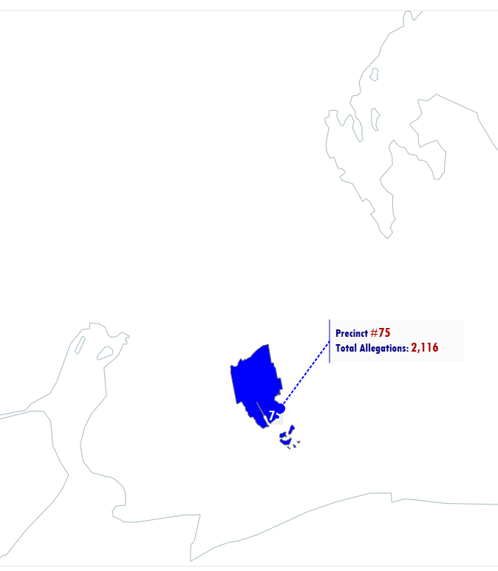
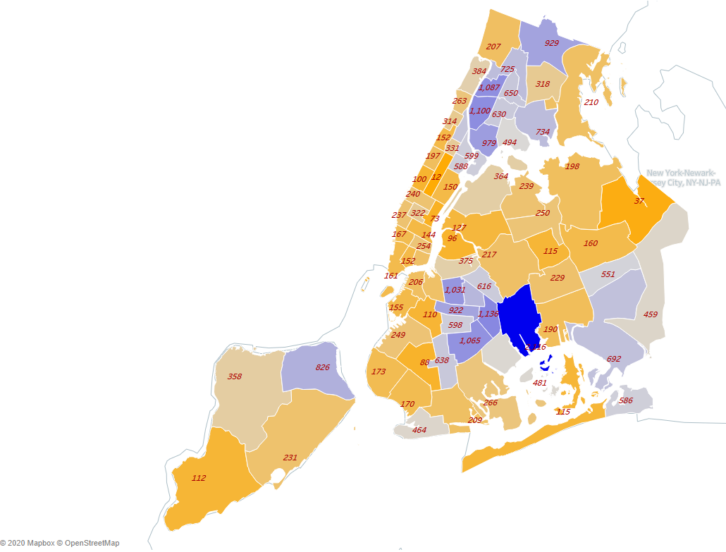
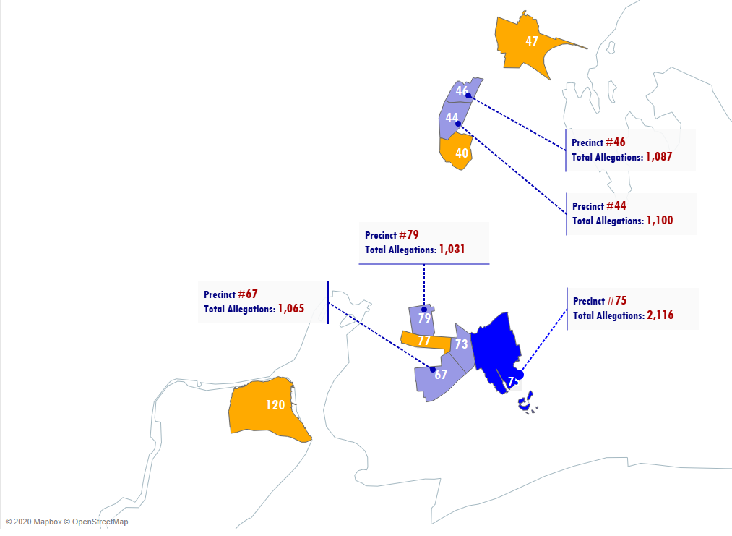
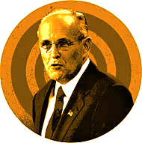



The Giuliani Era
Precinct #75 accounts for 4.5% of all allegations from 1994 to 2003
The Bloomberg Era
Precinct #75 accounts for 7.3% of all allegations from 2004 - 2013
The DeBlasio Era
Precinct #75 accounts for 5.9% of all allegations from 2014 to 2020

Slide 3
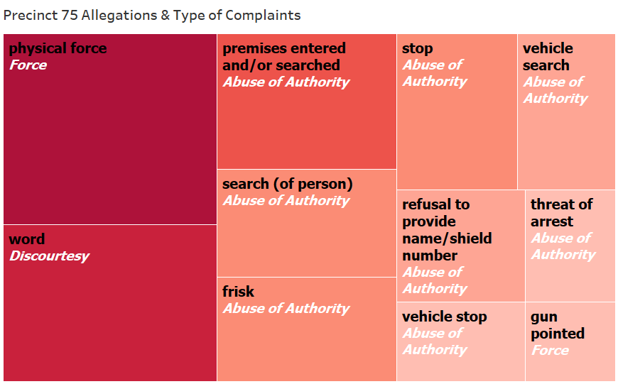
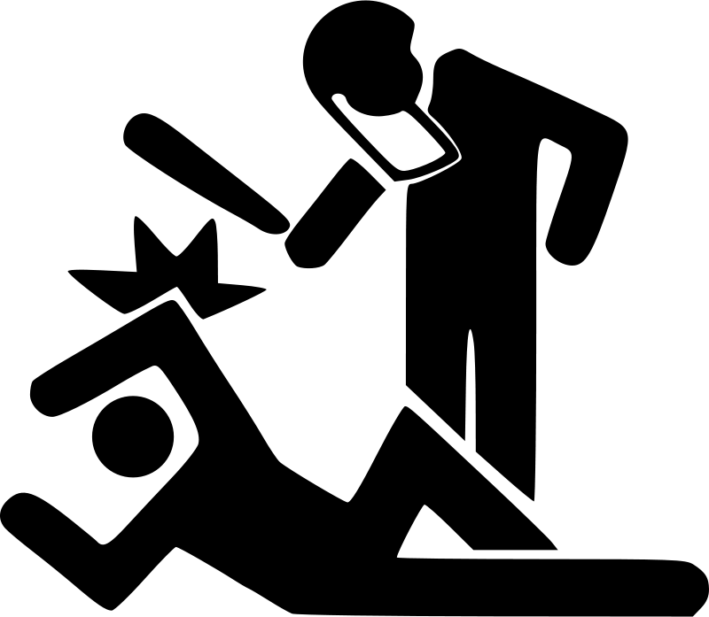



Top Allegations Against Precinct 75
Allegation (black) =
Specific type of complaints
Fado Type (white) =
Umbrella category of complaints

Slide 4
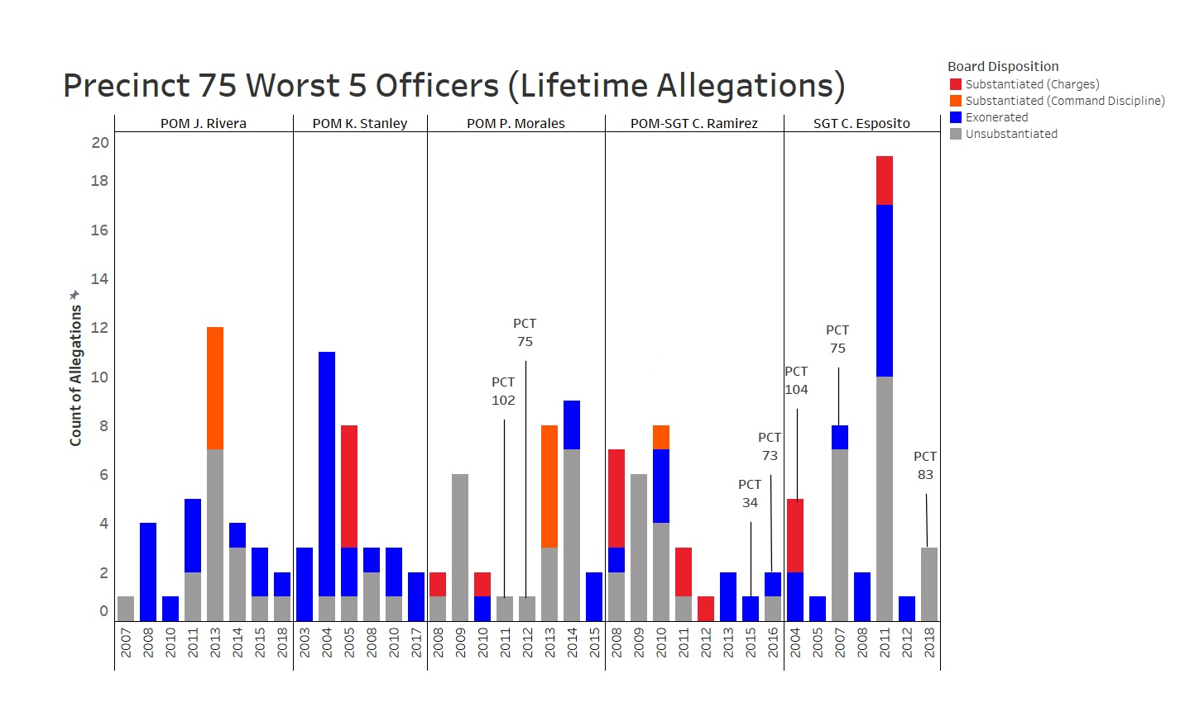

The PCT # annotation shows whenever a officer received an allegation outside of Precinct 75

